Slide 1
Bash Scripts on AOS 8.X Part of a presentation by Benjamin Domröse (ALE)

Slide 2
Bash
Bourne-again shell
Only on AOS 7.x/8.x, AOS 6 is based on VxWorks hence no Bash
Used directly on the AOS CLI, i.e. for sophisticated “show commands” or conditional changes on the config
Use the command “declare” to find out the actual version of Bash

Slide 3
Creating a Bash Script
Create a file with an editor you like i.e. VI
#!/bin/bash
echo “Hello World”
Change Permission to make it executable
chmod u+x <path>/hello.sh
Run the script
./hello.sh

Slide 4
Bash Script – Variables and $PATH
PATH is the variable, which tells BASH where to look for the programs (scripts, executables etc.)
echo $PATH
Create own variables
myVariable=“Content of my variable”
echo $myVariable
Show all variables created
set
set | grep MyVariable
Show functions and their content
type setPrompt
Common BuiltIn variables
PATH
HOME
SHELL
PWD
HISTFILE
USER

Slide 5
Bash Script – basic conditional constructs
IF ELSE FI
#!/bin/bash
if [ “ale" = “ale" ]; then
echo “True”;
else “False”;
fi
FOR Loop
#!/bin/bash
for i in $( ls ); do
echo item: $i;
done
While Loop
#!/bin/bash
COUNTER=0;
while [ $COUNTER -lt 10 ]; do
echo The counter is $COUNTER;
let COUNTER=COUNTER+1;
done

Slide 6
Bash Script – examples
Create VLAN´s
for x in 1000-1200;do vlan $x; done
Build a function for creating IP interfaces
function createipinterface ()
{ for ((i=1000;i<=1200;i++)) ;
do ip interface "VL$i" address 152.30.$(($i-1000)).1/24 vlan $i;
done; }
6465T-P12-> createipinterface
Create a number of user
function createuser ()
{ echo "Enter number of users: "
read N;
C="0";
while [ $C -lt $N ];
do user "Name$C" password testtest read-write all sha+des;
C=$[$C+1];
done;}
6465T-P12-> createuser

Slide 7
Bash Script – examples continued
Build a function with arguments
tagUplink ()
{
arr=($(show vlan | grep [0-9] | awk '{print $1}'));
for i in ${arr[@]};
do
vlan $i members port $1 tagged;
done
}
6465T-P12-> tagUplink “1/1/24”

Slide 8
Bash and regular expressions
Powerful way to search for patterns in strings
Match the string “Voice” with upper or lowercase “v”
show ip interface | egrep “[V,v]oice”
Match the string “192” followed by 3 digits and a “.”
show ip interface | egrep “192.[[:digit:]]{3}.”
Match the string “192.168” followed by a digit in the range of 3 to 5
show ip interface | egrep “192.168.[3-5]”
Lots of useful sources for more information out there
https://tldp.org/LDP/abs/html/x17129.html
Even online RegEx testers are available
https://regex101.com/

Slide 9
Bash and AWK
AWK is an tool for processing rows and columns and taking action on the output
AWK works on lines as input. When the given pattern is matched in the input line, the action is taken
Default field separator is “space”, which can be modified i.e. “;”
The fields are placed in $1, $2 to $NF (this is the last field, number of fields). $0 prints the entire line
Structure of AWK:
Syntax: awk '/search pattern1/ {Actions} /search pattern2/ {Actions}' file
AWK can be combined with grep, cat etc.
Report generation friendly
Syntax:
BEGIN { Actions}
{ACTION} # Action for everyline in a file
END { Actions }
Example:
show vlan | awk 'BEGIN {print "===Start of Report==="};{print $0};END {print "===End of Report==="}’ > MyVLANReport.txt

Slide 10
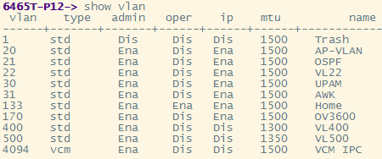
AWK example
Print VLAN ID´s and name
show vlan | awk ‘{print $1,$7}’
Print VLAN ID´s and name, if MTU is smaller than 1400
show vlan | awk ‘$6 < 1400 {print $1,$7}’
Print all VLAN ID´s and names between 100 and 199
show vlan | awk '$1 ~ /1[[:digit:]]{2}/ {print "VLAN ID between 100-199: ", $1,“Name: “, $7}’
Combined condition with modified output text
show vlan | awk '$3 = "Ena" && $6 > 1400 {print “Enabled VLANs with MTU greater 1400: “, $7}'

Slide 11
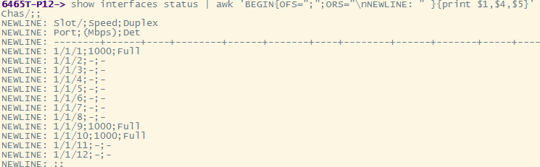
AWK patterns and built-in variables
Simple expressions
show vlan | awk '$6 == "1500" && $7 == "OSPF“’
Regular expressions
show log swlog | awk /[a-f0-9]{2}:[a-f0-9]{2}:[a-f0-9]{2}:[a-f0-9]{2}:[a-f0-9]{2}:[a-f0-9]{2}/
show ip interface | awk '$2 ~ /172\.[[:digit:]]{2}\./ {print $1,$2}’
Built-in Variables
NF – Number of Fields (Number of Fields in the line)
NR – Number of Records (Number of Lines)
FS – Field Separator (default is “space”: User modifiable)
OFS – Ouput Field Separator (default is “space”: User modifiable) – Can be used to generate CSV (with comma)
RS –Record Separator (default is new line “\n”: User modifiable)
ORS – Output Record Separator(default is new line “\n”: User modifiable)
IGNORECASE - (Can be set in BEGIN)

Slide 12
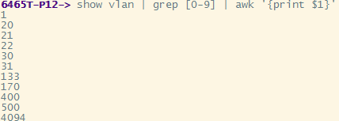
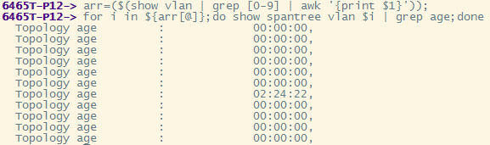
AWK advanced example
Get the topology age of all STP instances
1) Get all used VLANs
2) Create an array, containing all the VLANs
arr=($(show vlan | grep [0-9] | awk '{print $1}'));
3) Run a “For Loop” to check all topology ages
for i in ${arr[@]};do show spantree vlan $i | grep age;done

Slide 13
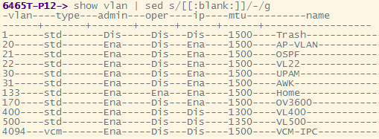
Bash with SED
Streamline editor, can be used to manipulate output on CLI and much more
Make output easier to read, replace a MAC with a name or prepare stuff to be processed further i.e. remove whitespaces or replace separators
Replacement of a MAC
show log swlog | sed ‘s/00:80:9f:aa:bb:cc/Subscriber#100/g’
Remove whitespaces
show vlan | sed ‘s/[[:blank:]]//g’
Replace whitespaces
show vlan | sed ‘s/[[:blank:]]/-/g’

Slide 14
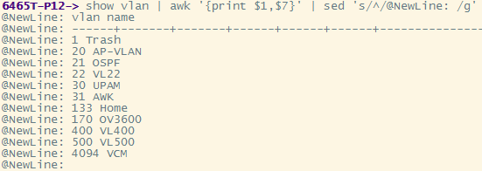
AWK with SED combined – 2 Examples
Get all details of all SPB Nodes
1) Create a clean LSP array, containing only the LSP-ID´s
arr=( $(show spb isis database | awk '{print $1;}’| egrep [0-9]| sed ‘s/[[:blank:]]//g') )
2) Get details of all LSP-ID´s in array
for i in ${arr[@]};do show spb isis database lsp-id $i;
Change the beginning of every line
show vlan | awk '{print $1,$7}' | sed 's/^/@NewLine: /g'

Slide 15
Writing AWK files
Write a file to check, if the second column contains a number and count it
vi numIP.awk
#!/bin/awk –f
# This program counts the number of IP interfaces in the switch
BEGIN { count = 0;};
$2 ~ /[0-9]+\./ {count++};
END {print "Number of IP Interface :", count;}
Give correct permission to the file
chmod +x numIP.awk
Pipe it, with the show command
show ip interface | ./numIP.awk

